Slide 1
Searching
Searching Technique
Sequential Search
Binary Search

Slide 2
Searching
Why searching is important?
Most frequent operation in a computer.
Knuth says over 25% of computer time in 60’s was used in searching.
Generally we search for solutions or answers in databases or in computation intensive problems.
Our shops are arranged to minimize searching time, as is the chess board or household goods, admission test results or even dictionaries.

Slide 3
Searching
Searching Technique
Sequential Search
Binary Search

Slide 4
Searching Algorithm
Problem: Given a sorted array and a key, find index of the key in the array.
Solve: Sequential Search
Complexity: ?
0 | 1 | 2 | 3 | 4 | 5 | 6 | 7 | 8 | 9 | 10 | 11 | 12 | 13 | 14
6 | 14 | 25 | 33 | 35 | 40 | 49 | 55 | 58 | 60 | 69 | 77 | 88 | 91 | 93
Sequential_search(A, n, z, index)
i = 1, index = -1
While i <= n and A(i) ≠ z do
i++
enddo
If i <= n then
index = i
endif

Slide 5
Sequential Search
Problem: Can you do better? (hint: every instruction takes time)
Sequential_search_1(A, n, z, index)
i = 1, index = -1
While i <= n and A(i) ≠ z do
i++
enddo
If i <= n then
index = i
endif
Sequential_search_2(A, n, z, index)
A(n+1) = z, i = 1, index = -1
While A(i) ≠ z do
i++
enddo
If i <= n then
index = i
endif

Slide 6
Sequential Search
Why algorithm 2 is better?
In sequential_search_2 algorithm i <= n index comparison is not required
Even if the element were not in the list it has been kept at (n+1)st location we are not going to run out of the array.
Sequential_search_2(A, n, z, index)
A(n+1) = z, i = 1, index = -1
While A(i) ≠ z do
i++
enddo
If i <= n then
index = i
endif

Slide 7
Sequential Search
Sequential Search complexity
Operation | Best Case | Worst Case | Average Case
Successful Search | 1 | n | (n+1) / 2
Unsuccessful Search | n | n | n

Slide 8
Searching Algorithm
Sequential Search complexity
However, when n is very large and we need to search out too many elements sequential search would be too costly to pursue.
Imagine had your roll numbers in the successful lists of DU admission test or that at BUET appeared in no order how difficult would it have been for you to go through the whole list, on the average half of it, to find your name or after the list is exhausted you come to learn that you are unsuccessful.

Slide 9
Searching
Searching Technique
Sequential Search
Binary Search
Guessing Game?

Slide 10
Binary Search
Problem: Given a sorted array and a key, find index of the key in the array.
Binary search. Compare key against middle entry.
Too small, go left.
Too big, go right.
Equal, found.
0 | 1 | 2 | 3 | 4 | 5 | 6 | 7 | 8 | 9 | 10 | 11 | 12 | 13 | 14
6 | 14 | 25 | 33 | 35 | 40 | 49 | 55 | 58 | 60 | 69 | 77 | 88 | 91 | 93

Slide 11
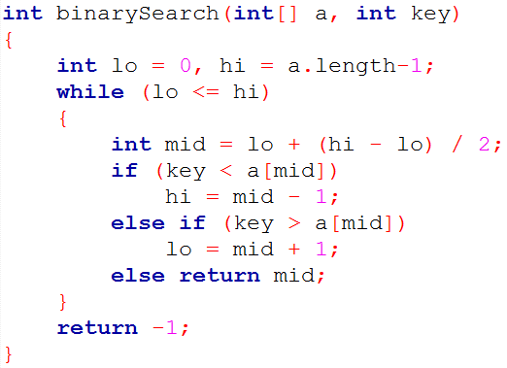
Binary Search
Loop invariant?
If key appears in the array a[], then a[lo] ≤ key ≤ a[hi].

Slide 12
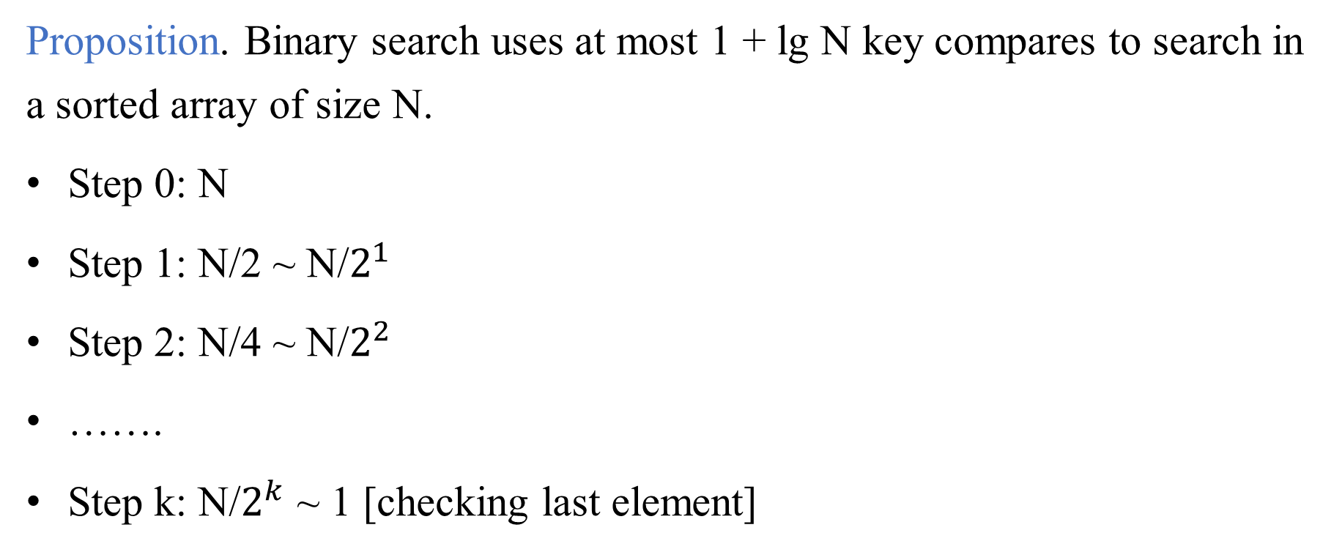
Binary Search : mathematical analysis
Proposition. Binary search uses at most 1 + lg N key compares to search in a sorted array of size N.
Step 0: N
Step 1: N/2 ~ N/$2^{1}$
Step 2: N/4 ~ N/$2^{2}$
…….
Step k: N/$2^{k}$ ~ 1 [checking last element]

Slide 13
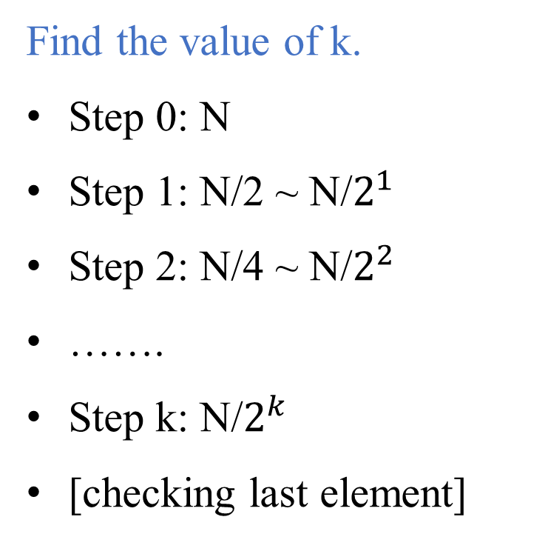
Binary Search : mathematical analysis
Find the value of k.
Step 0: N
Step 1: N/2 ~ N/$2^{1}$
Step 2: N/4 ~ N/$2^{2}$
…….
Step k: N/$2^{k}$
[checking last element]

Slide 14
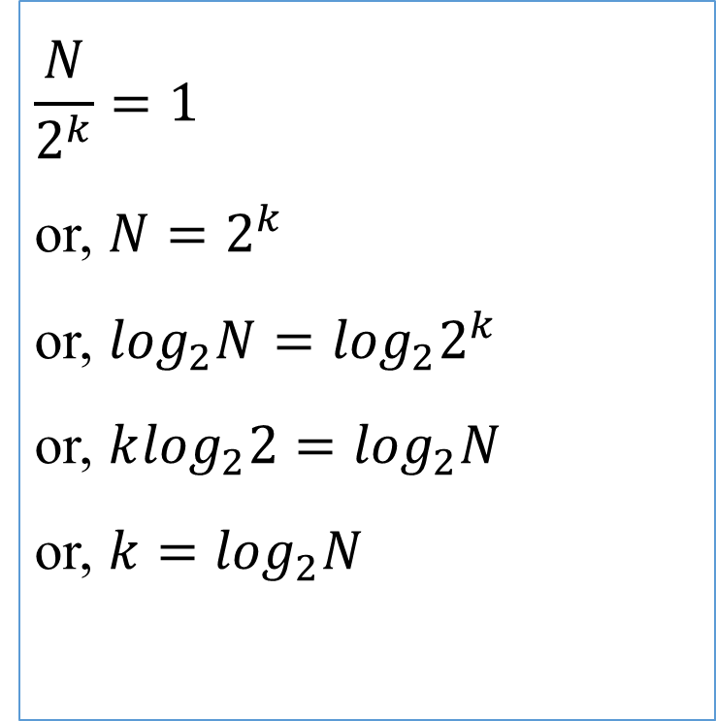
Binary Search : mathematical analysis
Find the value of k.
Step 0: N
Step 1: N/2 ~ N/$2^{1}$
Step 2: N/4 ~ N/$2^{2}$
…….
Step k: N/$2^{k}$
[checking last element]
$$\frac{N}{2^{k}}=1$$
or, $N=2^{k}$
or, $\log_{2}N=\log_{2}2^{k}$
or, $k\log_{2}2=\log_{2}N$
or, $k=\log_{2}N$

Slide 15
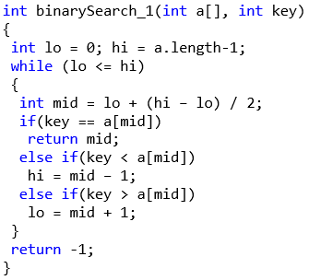
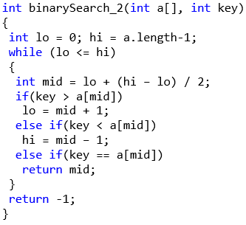
Binary Search : Which algorithm is better?

Slide 16
Other searches
Dictionary searching is interpolation search.
Hashing is another way of searching efficiently. We can store elements at a location that is function of the element. Say we want to store “dog” we compute location as 4+15+7=26. If number of location cannot exceed m then we take 26 mod m and store “dog” there if it is empty. If not follow some hash collision resolution procedure.

Slide 17
Searching
Searching Technique
Sequential Search
Binary Search

